Slide 1
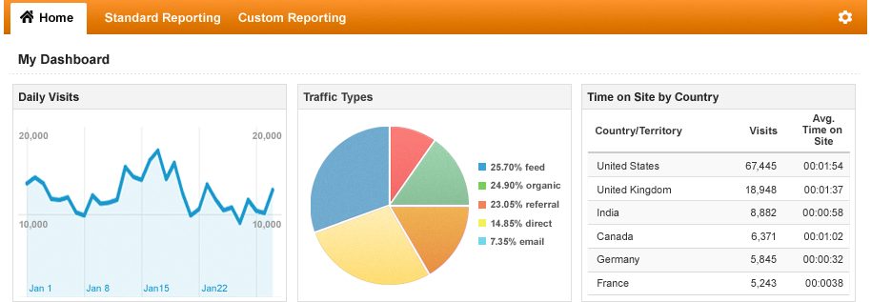

Google Analytics – a free measurement tool for the business
“Google Analytics a powerful tool to know the business needs.”

Slide 2

Google Analytics – a free measurement tool for the business
Key Features Real-time reports Custom Reports and Variables Advanced Segmentation Analytics Intelligence Mobile Solutions Social Analytics Content Analytics Advertising Analytics Campaign Measurement Flow Visualization Sites Using Google Analytics Twitter MySpace DailyMotion Answers.com Just 3 steps away for Google Analytics Sign up for Account Define Account properties Set up the Tracking Code And you are DONE! | About Google Analytics Google Analytics as the web analytics platform is a powerful and easy-to-use reporting tool. This sophisticated tool helps the site owner to understand which part of the site is performing well, which pages are more popular, how often the end user visits your site and so on and that makes the site owner to understand the customer need and thus making the customer glued to your site. The prime feature of Google Analytics is it aids the site owner to find out how many customers the site is attracting, how much is the business and how end users are engaged with the site. Benefits 24/7 Support, dedicated account manager, high-touch, around –the-clock technical support. Track Billions of hits per month and guarantees data freshness. Report high data volumes with no sampling. Provides multiple advertising options like Attribution Modeling, Campaign Measurement, Adwords Integration, Multi-channel reporting, Analytics intelligence and Flow Visualization. Google Analytics helps to measure the impact of mobile on the site business. Additionally, if there is a mobile apps, Google Analytics offers Software Development Kits for iOS and Android so that it helps to measure how people use the mobile app. The web is a social place and Google Analytics measures success of the social media programs. The tool can analyze how visitors interact with sharing features on the site (like the FBLike, Google +1 button) and engage with the content across social platforms. Google Analytics not a mere measuring tool on sales and conversions, but also gives fresh insights into how visitors use the site, how they arrived on the site, and how one can keep them coming back. NoW You can setup GOOGLE ANALYTICS WITH Multiple Domains with subdomain 404 Tracking Event tracking Google Analytics at Standard (Free) and Premium rates ($150,000 Annual Flat Fee)

